Slide 1



Real World Scalability
Mark Doyle
mark.doyle@improving.com
@mark_doyle_ftw
linkedin.com/in/spencermarkdoyle
Materials on GitHub: https://github.com/mark-doyle/dal-cs-sig

Slide 2
What is Scalability?
Writing better or more performant code | Thoughtful, efficient code Asynchronous programming Parallelism
Implementing improved architecture or design | Data / calculation storage Disconnected / async processing Caching Compression
Hardware or environment solutions | Data center considerations Scale up Scale out

Slide 3

Asynchronous Programming
Async / Await
PROS | CONS
Frees up main thread during network/storage operations Beneficial for network- or storage-intensive solutions | Challenging to partially implement Deadlocking potential Thread pool management performance Little benefit to single-threaded or CPU-intensive solutions

Slide 4


Parallelism
Without async / await
With async / await

Slide 5

Caching
In-memory caching
PROS | CONS
Readily-accessible objects & data Faster access than network-based resources Fewer storage transactions Lower cost* | Memory pressure expiring cache Stale objects

Slide 6
Caching (continued)
Distributed cache (e.g., Redis, Memcached)
Hybrid cache (in-memory + distributed)
PROS | CONS
Cache accessible to numerous processes / machines Fewer storage transactions | Network-based resource (more network transactions) Cost Serialization

Slide 7
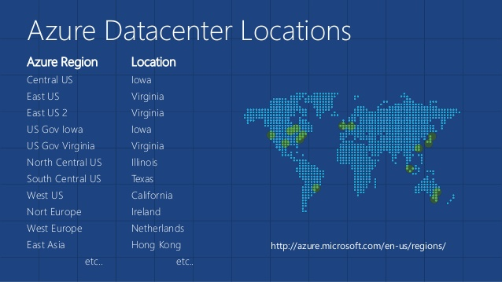
Data Center Considerations
Proximity matters: Same location = low latency

Slide 8
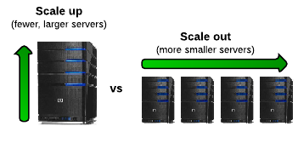
Scaling
PROS | CONS
Better performance | Cost Idle hardware (unless auto-scaling)

Slide 9
Azure Management
Look at the tools
Management portal (old & new)
Azure Management Studio
Features
Service location management
Service scaling

Slide 10
Load Testing
See the code…

Slide 11
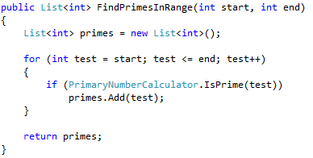
Problem 1 – CPU Bound Operations
Example: Primary number calculation

Slide 12
Problem 1 – CPU Bound Operations
Solution 2: Async/await, no caching
Solution 3: Caching, no async/await
Solution 4: Caching, with async/await

Slide 13
Problem 1 – CPU Bound Operations
See the code…

Slide 14
Problem 1 – CPU Bound Operations
Results
# | Cached | Async | Avg Time | Total Tests | Test Time
1 | No | No | 0.21 | 2,534 | 532
2 | Yes | No | 0.20 | 2,487 | 497
3 | No | Yes | 0.24 | 2,489 | 597
4 | Yes | Yes | 0.14 | 2,454 | 344
Async with caching is most performant
Async without caching is least performant

Slide 15
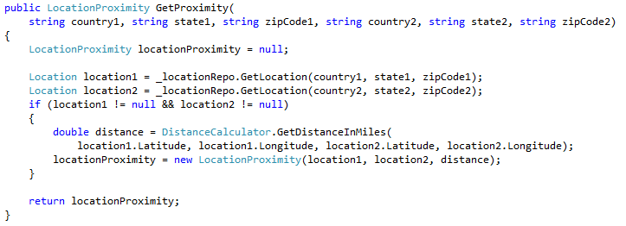
Problem 2 – Storage Read with CPU
Example: Proximity calculation between two locations

Slide 16
Problem 2 – Storage Read with CPU
Solution variables
Synchronous versus async/await
Storing results
Caching
Pre-loading locations

Slide 17
Problem 2 – Storage Read with CPU
See the code…

Slide 18
Problem 2 – Storage Read with CPU
Results
# | Stored | Cached | Async | Pre-load | Avg Time | Total Tests | Test Time
1 | No | No | No | No | 0.27 | 2,190 | 591
2 | Yes | No | No | No | 0.27 | 2,224 | 600
3 | Yes | Yes | No | No | 0.26 | 2,076 | 540
4 | Yes | Yes | No | Yes | 0.26 | 2,146 | 558
5 | No | No | Yes | No | 0.32 | 2,153 | 689
6 | Yes | No | Yes | No | 0.32 | 2,123 | 679
7 | Yes | Yes | Yes | No | 0.23 | 2,087 | 480
8 | Yes | Yes | Yes | Yes | 0.22 | 2,106 | 463

Slide 19
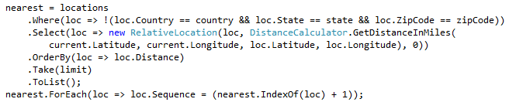
Problem 3 – Large Dataset Calculations
Example: Find closest locations

Slide 20
Problem 3 – Large Dataset Calculations
Solution 2: Async/await, no caching
Solution 3: Distributed caching, no async/await
Solution 4: Distributed caching, with async/await

Slide 21
Problem 3 – Large Dataset Calculations
See the code…

Slide 22
Problem 3 – Large Dataset Calculations
Results
# | Cached | Async | Avg Time | Total Tests | Test Time
1 | No | No | 0.27 | 2,085 | 563
2 | Yes | No | 0.27 | 2,139 | 578
3 | No | Yes | 0.24 | 2,056 | 493
4 | Yes | Yes | 0.32 | 2,104 | 673
Async without caching was more performant

Slide 23
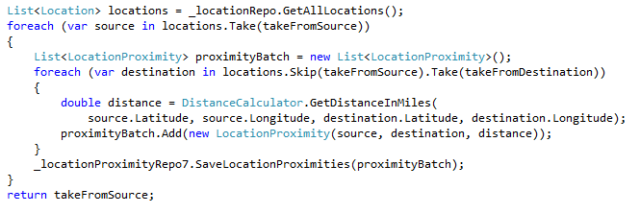
Problem 4 – Storage Bound Operations
Example: Calculate proximity of range of locations
Solution 2: Async/await

Slide 24
Problem 4 – Storage Bound Operations
See the code…

Slide 25
Problem 4 – Storage Bound Operations
Results
# | Async | Avg Time | Total Tests | Test Time
1 | No | 2.73 | 273 | 745
2 | Yes | 2.66 | 248 | 660
Async was more performant

Slide 26
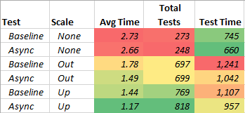
What About Scale?
Scaling UP amplified caching & async improvements
more than scaling OUT

Slide 27
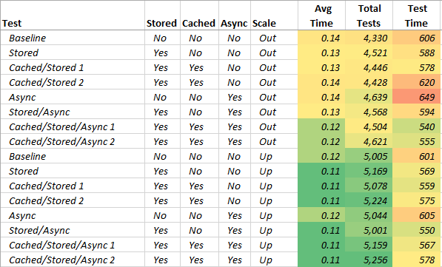
More Scaling Results

Slide 28
Conclusion
Load Testing
Load testing is cyclical – build, test, adjust, repeat
If possible, run using Visual Studio Team Services (in Azure)
Try various scenarios
surge vs gradual usage
sporadic vs sustained
Verbose logging, if possible
stopwatch timings
data queries

Slide 29
Conclusion (continued)
Caching
Determine forced expiration vs timed expiration
In-memory vs distributed vs hybrid
Redis
https://azure.microsoft.com/en-us/services/cache/
https://github.com/StackExchange/StackExchange.Redis

Slide 30
Conclusion (continued)
Asynchronous / Parallel Processing
Not always ideal
Can better balance load
high-volume threading scenarios
high-volume network- or storage-intensive operations
More info: http://blog.stephencleary.com/

Slide 31
Conclusion (continued)
Scaling
Find minimum acceptable “scale up” for off-peak, then scale out
Take advantage of auto-scaling, if possible
Load-based
Time-based
Special scenarios
Azure Auto-scaling:
https://azure.microsoft.com/en-us/documentation/articles/cloud-services-how-to-scale/

Slide 32
Questions or Comments?
Mark Doyle
mark.doyle@improving.com
@mark_doyle_ftw
linkedin.com/in/spencermarkdoyle

